Slide 1
Stock Market Analysis
FEAR vs Neutral vs Greed

Slide 2
Trader Behaviour Analysis Based on Market Sentiment
For the job role “Junior Data Scientist ”
The goal of this project is to analyze how Bitcoin market sentiment (Fear, Greed, Extreme Fear, Extreme Greed) impacts trader behavior and profitability using historical trade data.

Slide 3
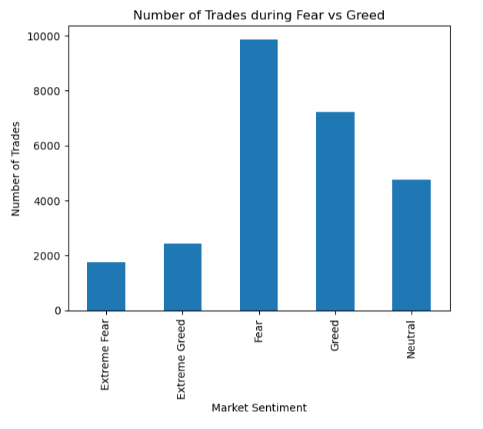
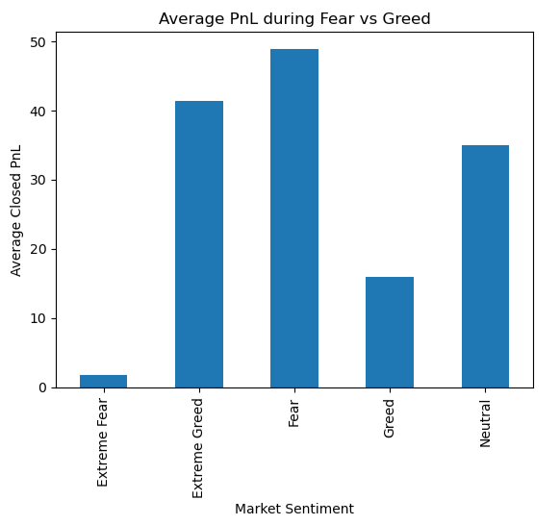
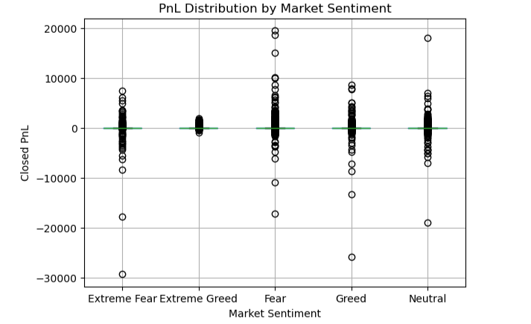
Visualizations

Slide 4
Key Insights
The median PnL across all sentiment categories is zero, indicating that more than half of trades close without profit or loss.
- Average PnL differs across sentiment regimes, suggesting that overall profitability is driven by a smaller number of high-impact trades.
- Trade activity is higher during Greed and Extreme Greed periods compared to Fear-based periods.
- PnL distributions during Greed show higher volatility, indicating both higher potential gains and larger losses.

Slide 5
THANK YOU!

